Slide 1
Ghidra-LLM: Large Language Models for Static Reverse Engineering
Senior Design Project Final Presentation
Justin Rockwell

Slide 2
Project Overview
Project Goal: Integrate large language models (LLMs) into NSA’s Ghidra tool for static reverse engineering.
Key Objective: Improve the explainability and coherency of reverse-engineered binaries using finetuned LLaMa2 and Deepseek.
Sponsor: Md Tanvir Arafin, Assistant Professor Mentor: Dr. Coffman

Slide 3
Why This Project?
LLM4Decompile
Problem Statement: Reverse engineering suffers from explainability issues due to the lossy nature of code compilation.
Model | Size | Re-executability
llm4decompile-6.7b-v1.5 | 6.7B | 45.40%
llm4decompile-1.3b-v2 | 1.3B | 46.00%
llm4decompile-6.7b-v2 | 6.7B | 52.70%
llm4decompile-9b-v2 | 9B | 64.90%
llm4decompile-22b-v2 | 22B | 63.60%

Slide 4
My Research Focus
Research Focus: Applying Retrieval-Augmented Generation (RAG) to improve LLM4Decompile’s accuracy.
Key Benefit of RAG: Combines LLMs with a retrieval system to better correlate source code with its assembly version.

Slide 5
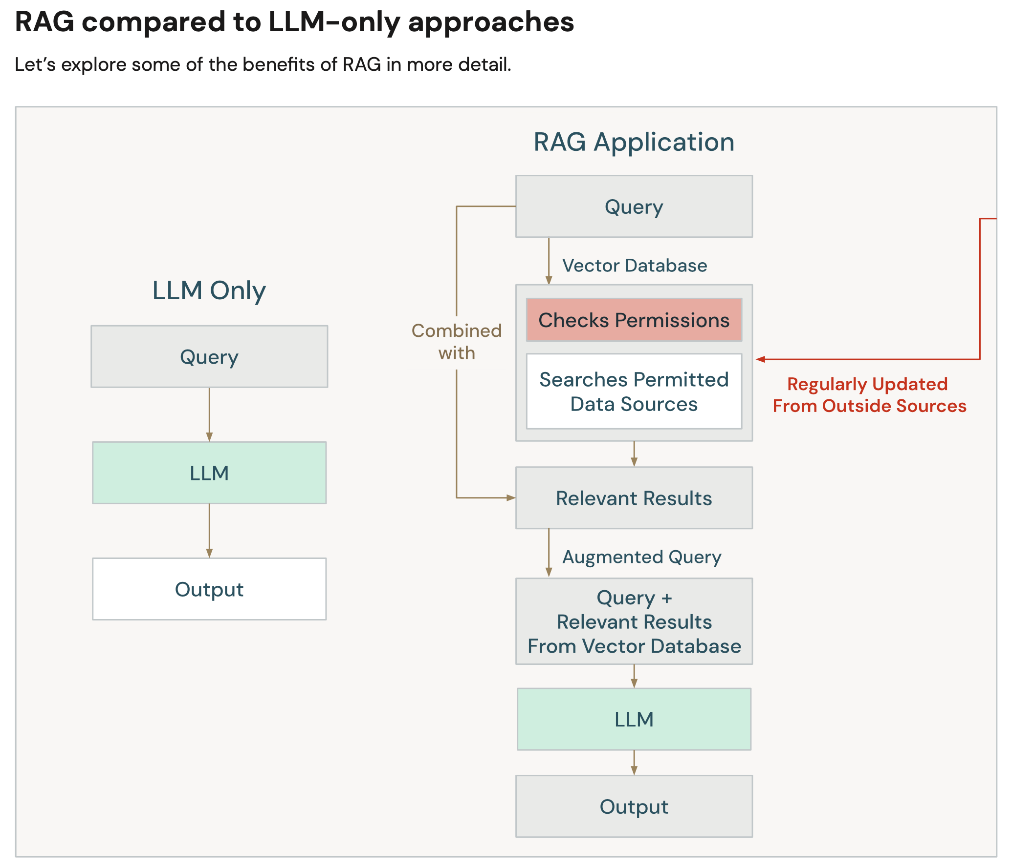
How RAG Works
Process
Process Overview:
Retrieve relevant code snippets or documentation.
Augment the language model with retrieved data.
Generate more accurate and contextualized explanations.
End
End Goal:
Increase the precision of reverse engineering tasks within Ghidra.
DataBricks. (n.d.). RAG compared to LLM only. In A Compact Guide to Retrieval Augmented Generation (RAG) (p. 12). essay, Apache. Retrieved 2024,.

Slide 6
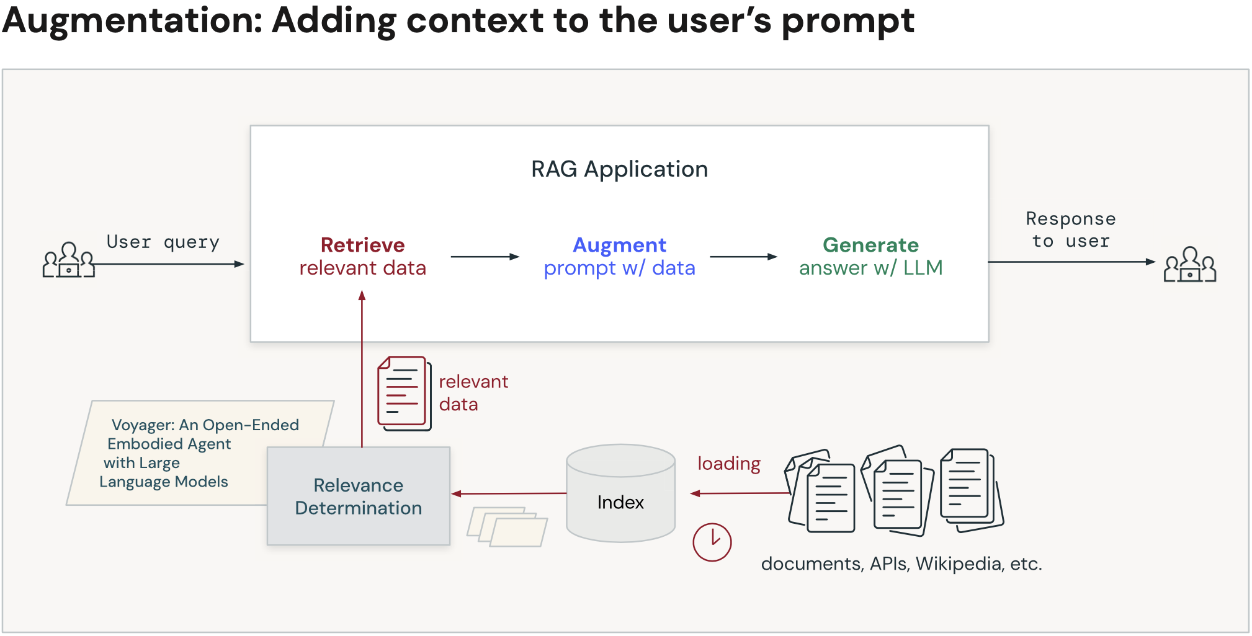
Impact on the Project
Project Contributions:
RAG will enhance Ghidra’s explainability by reducing ambiguity in decompiled code.
This improves the overall accuracy and efficiency of reverse engineering tasks.
DataBricks. (n.d.). RAG compared to LLM only. In A Compact Guide to Retrieval Augmented Generation (RAG) (p. 23). essay, Apache. Retrieved 2024,.

Slide 7
Next Steps
Short-term Goals:
Continue finetuning LLM4Decompile and its use of Ghidra.
Integrate RAG to improve decompilation results.
Long-term Goals:
Test effectiveness in static reverse engineering (SRE) tasks.
Complete final report and tool demonstration.

Slide 8
Building RAG Pipeline
DataBricks. (n.d.). RAG compared to LLM only. In A Compact Guide to Retrieval Augmented Generation (RAG) (p. 23). essay, Apache. Retrieved 2024,.

Slide 9
Build the RAG Database
C files
Assembly files
CFG
JSON
Neo4j
Exebench
GCC
GCC
Python
Python

Slide 10
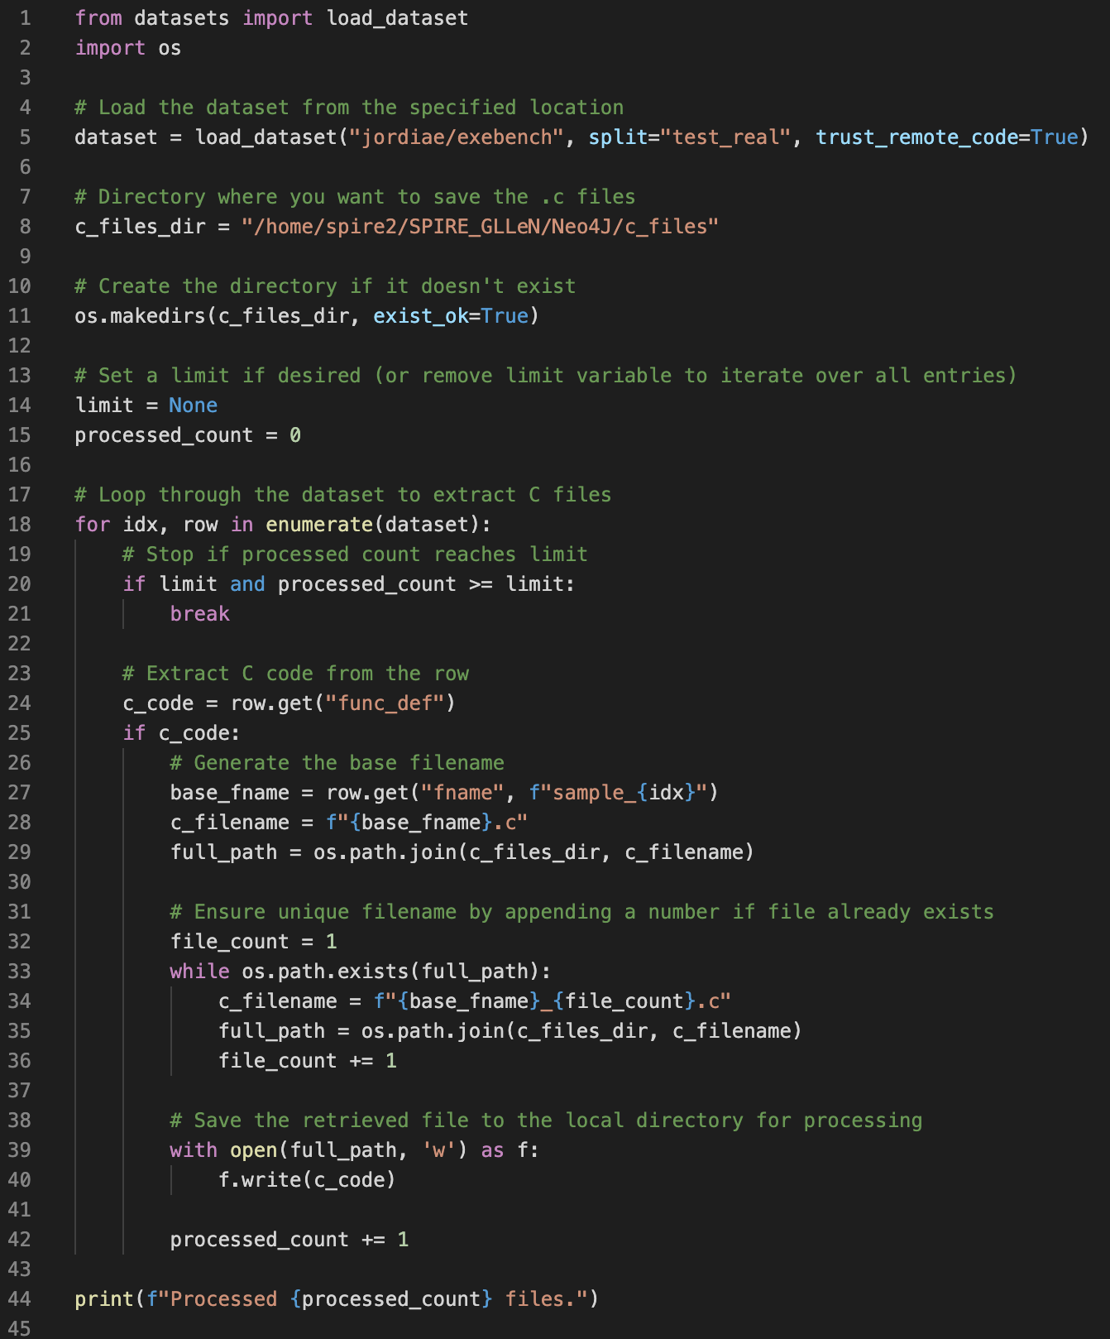
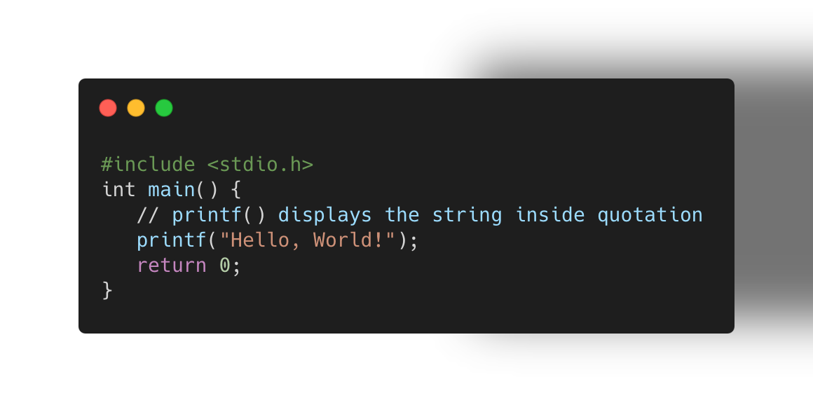
C files
Assembly files
CFG
JSON
Neo4j
Exebench
GCC
GCC
Python
Python
ExeBenchToC.py

Slide 11
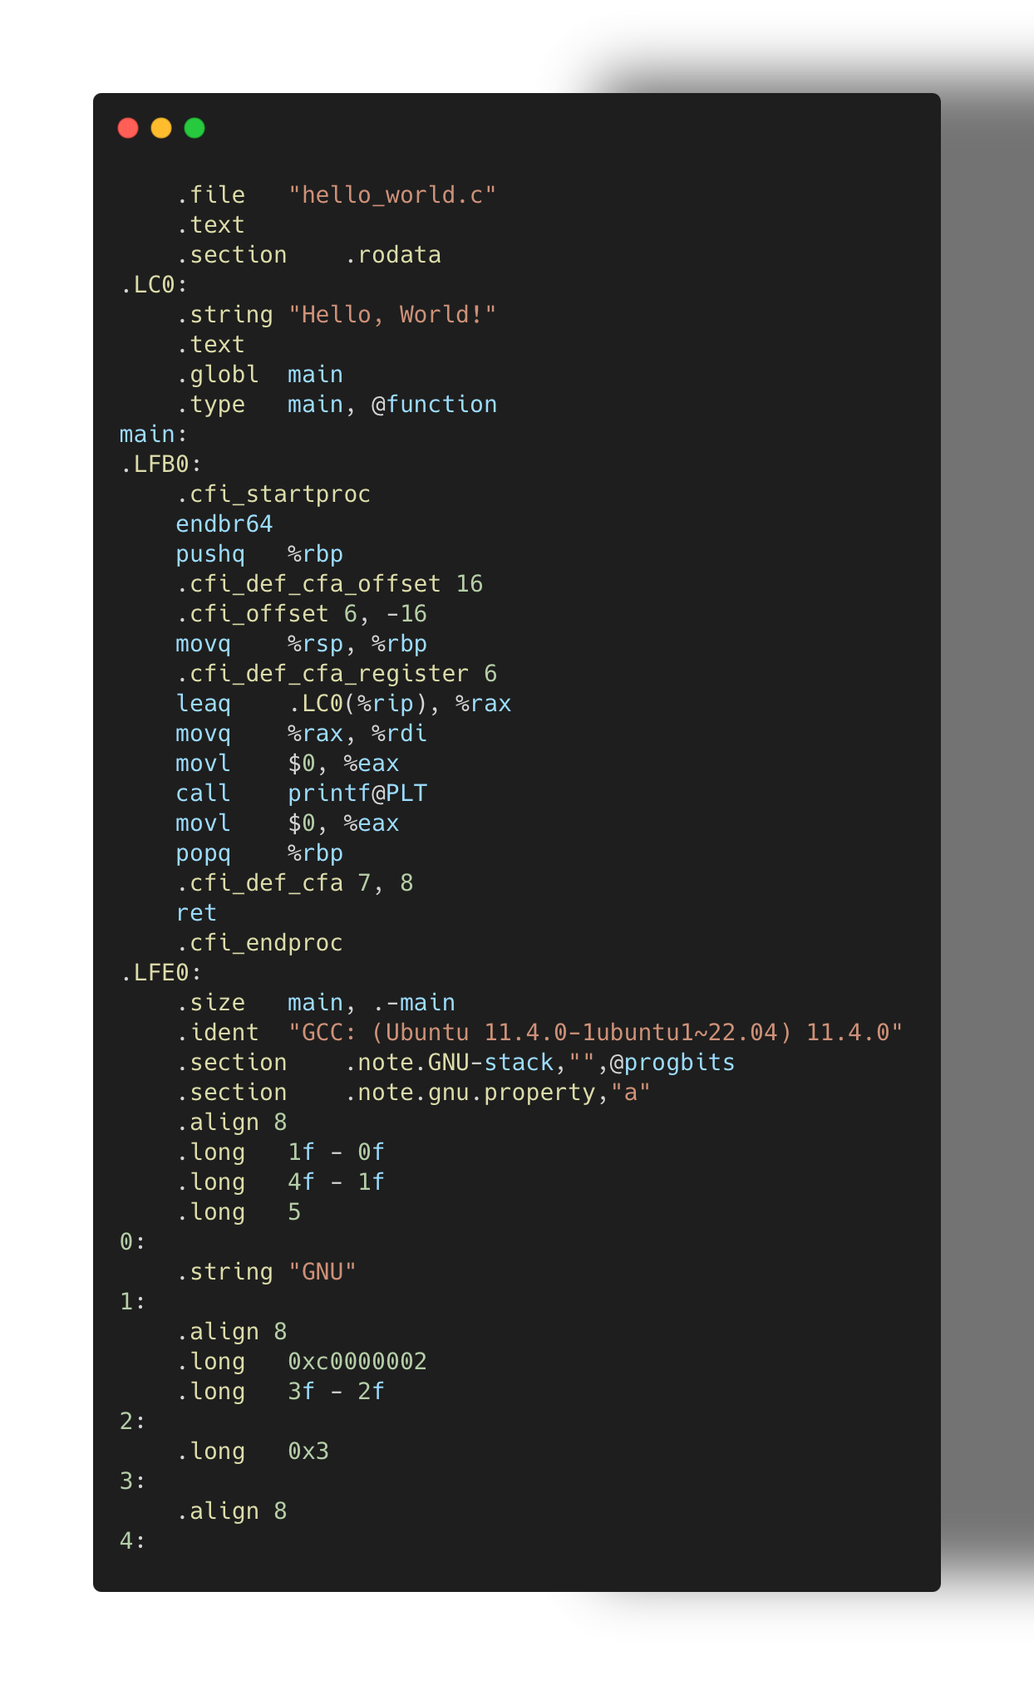
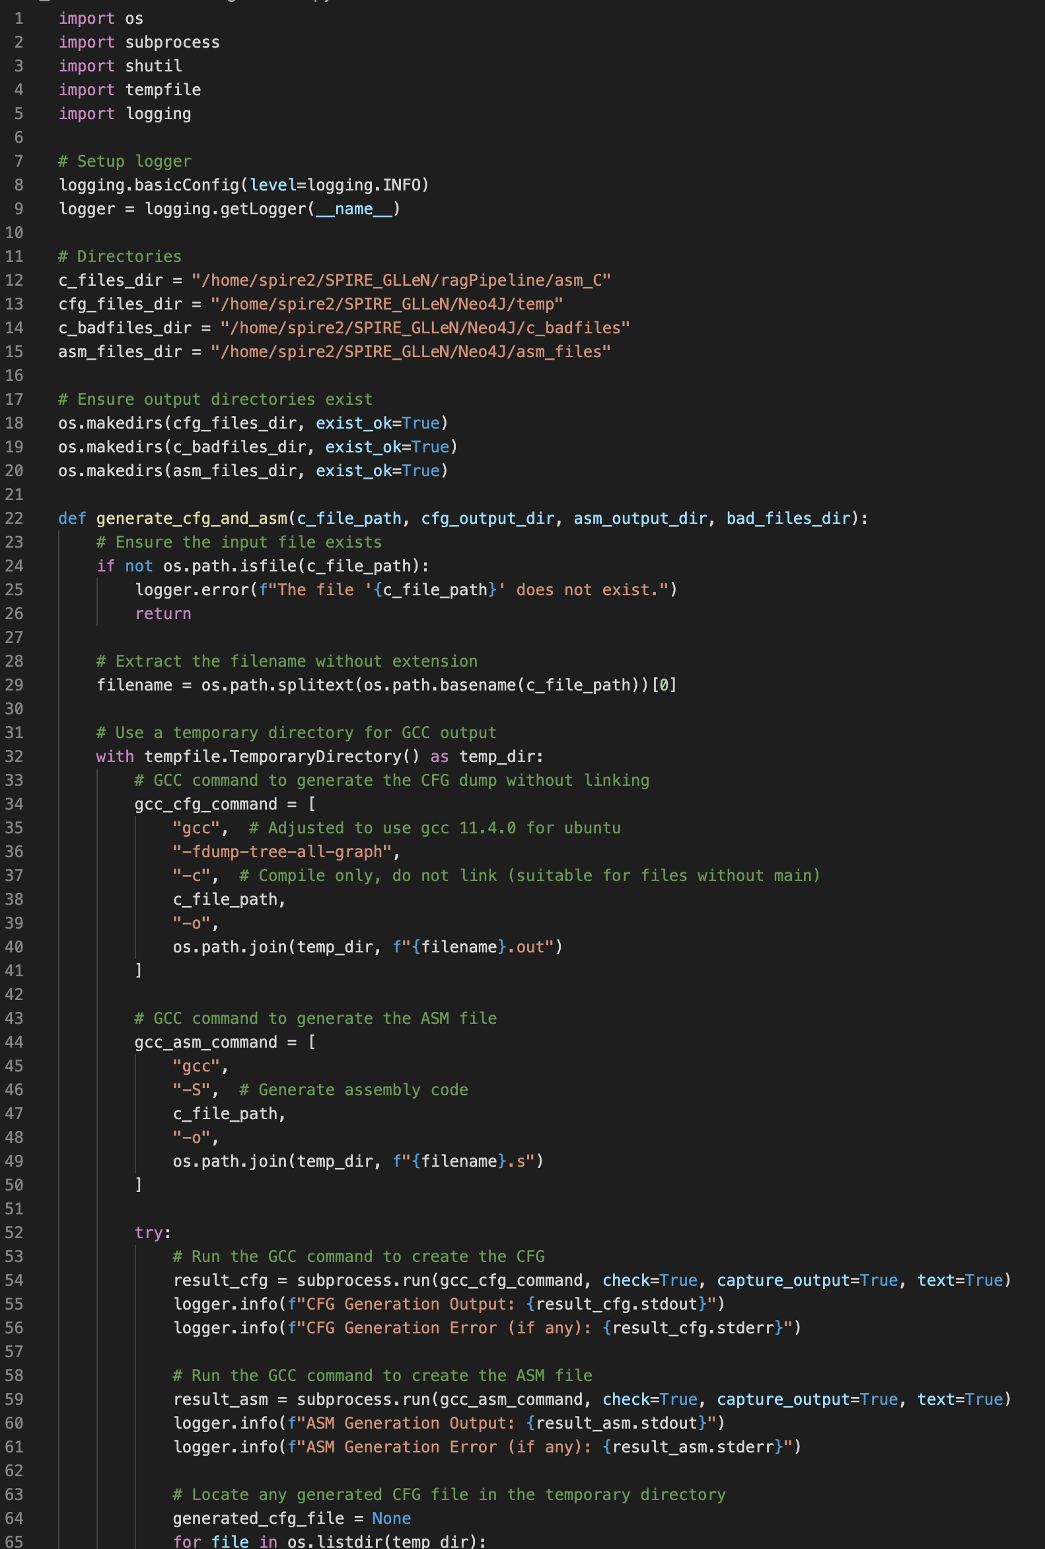
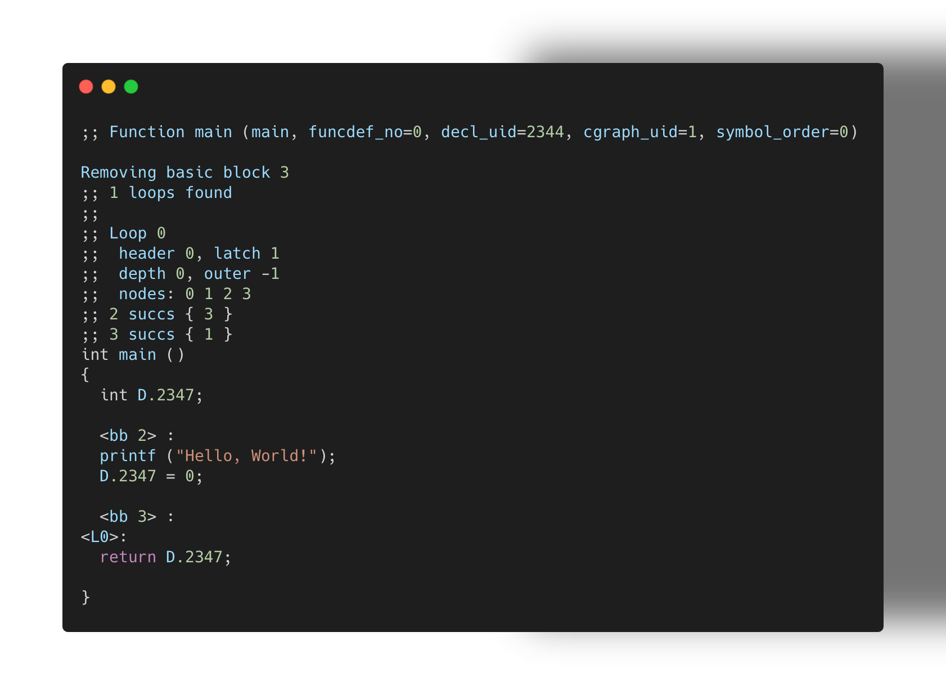
C files
Assembly files
CFG
JSON
Neo4j
Exebench
GCC
GCC
Python
Python
gccToCFG.py

Slide 12
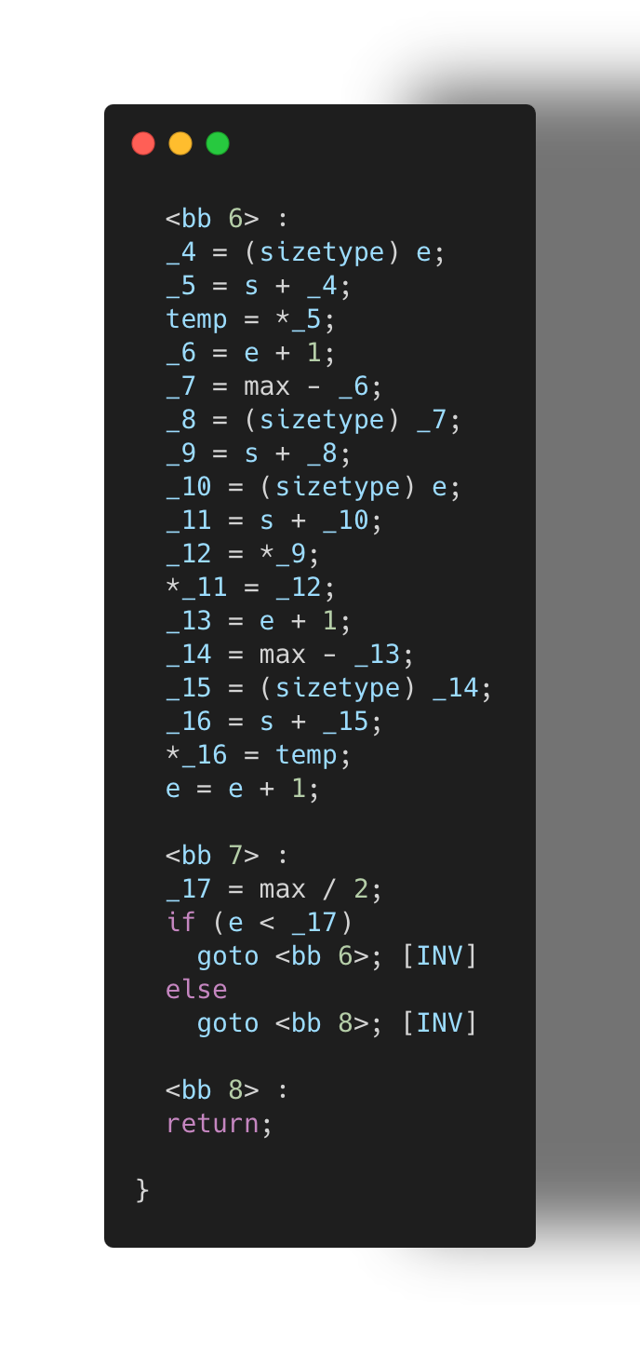
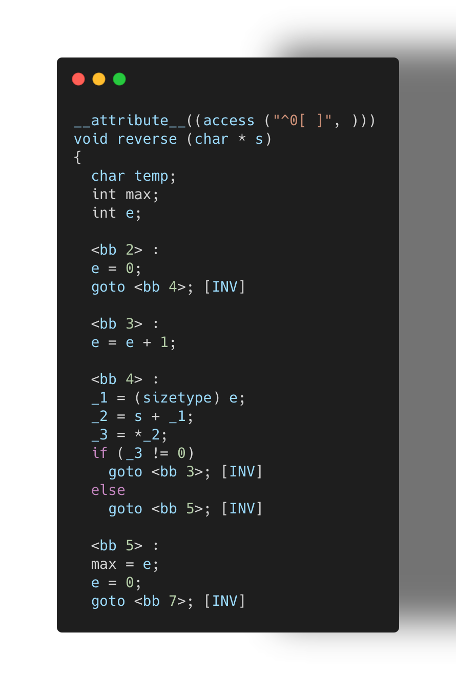
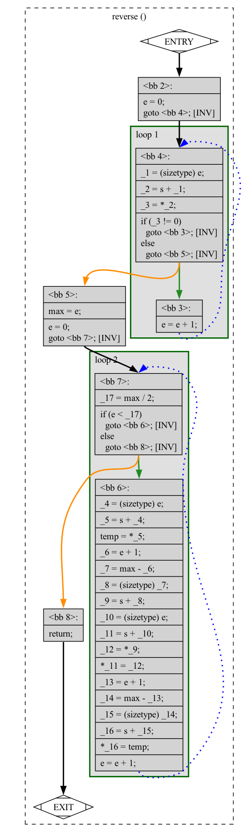
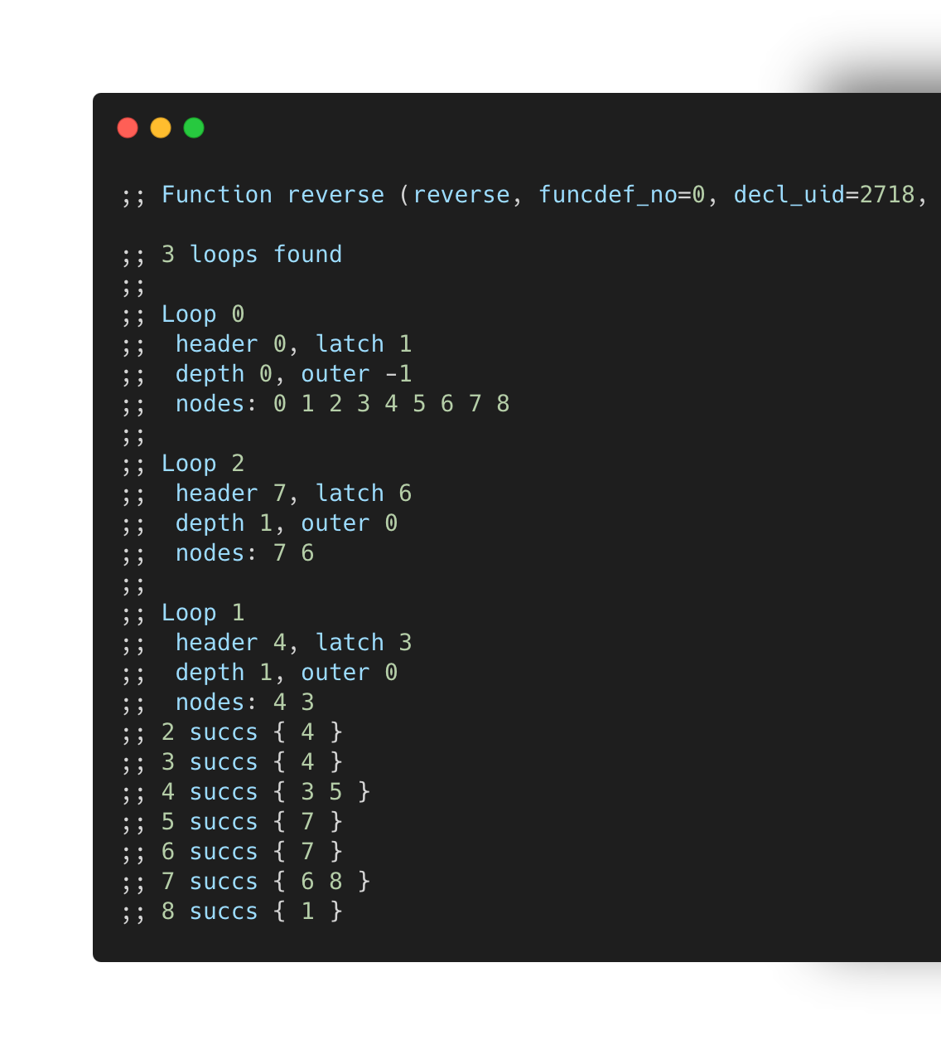
C files
Assembly files
CFG
JSON
Neo4j
Exebench
GCC
GCC
Python
Python

Slide 13
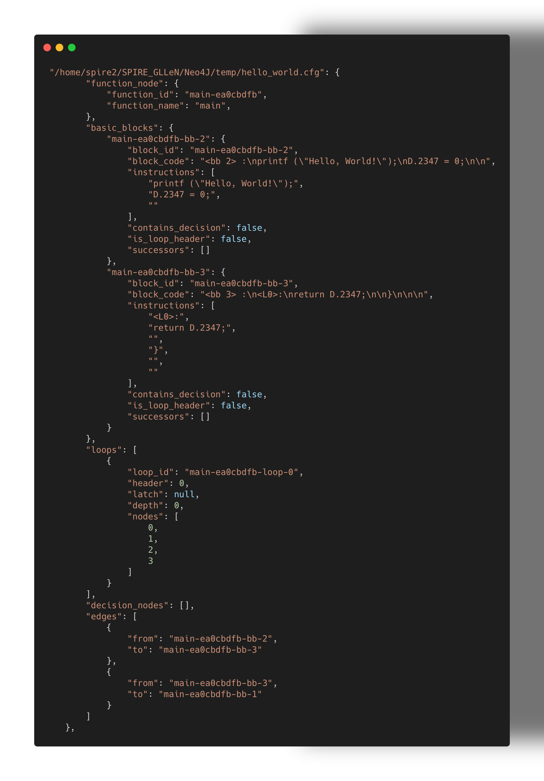
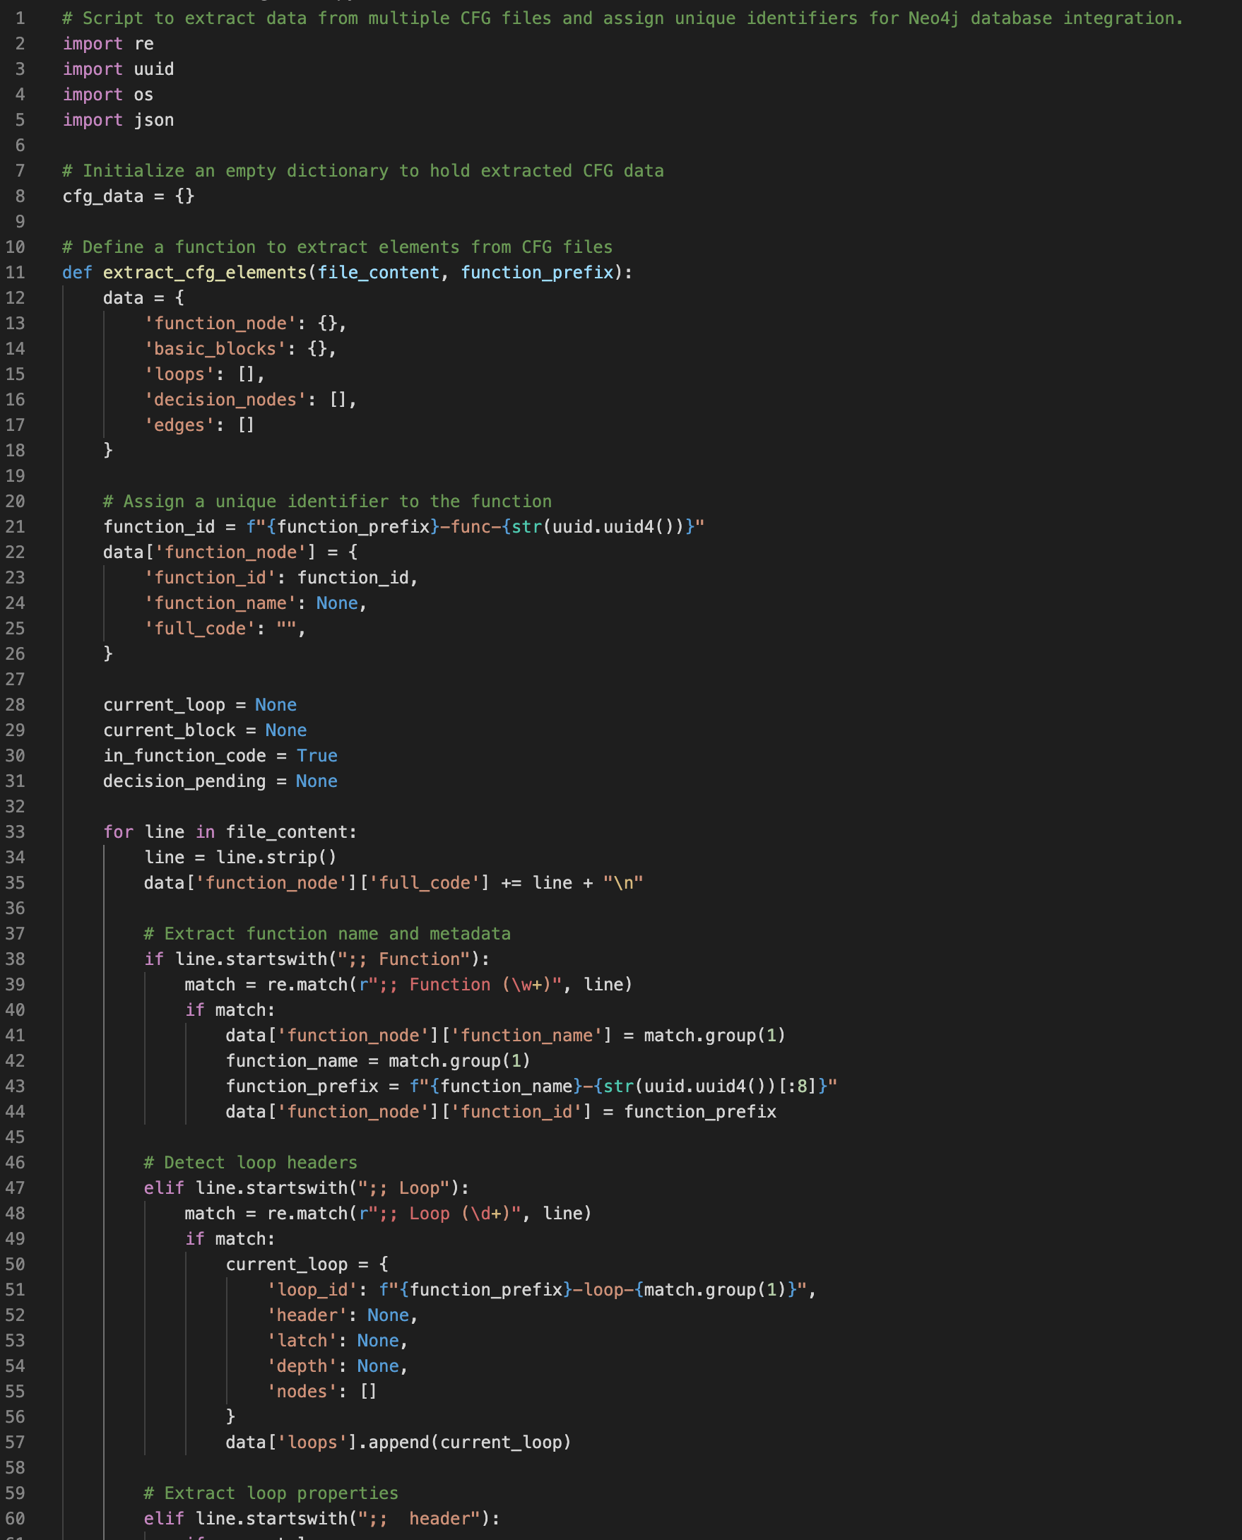
C files
Assembly files
CFG
JSON
Neo4j
Exebench
GCC
GCC
Python
Python
cfgToJSON.py

Slide 14
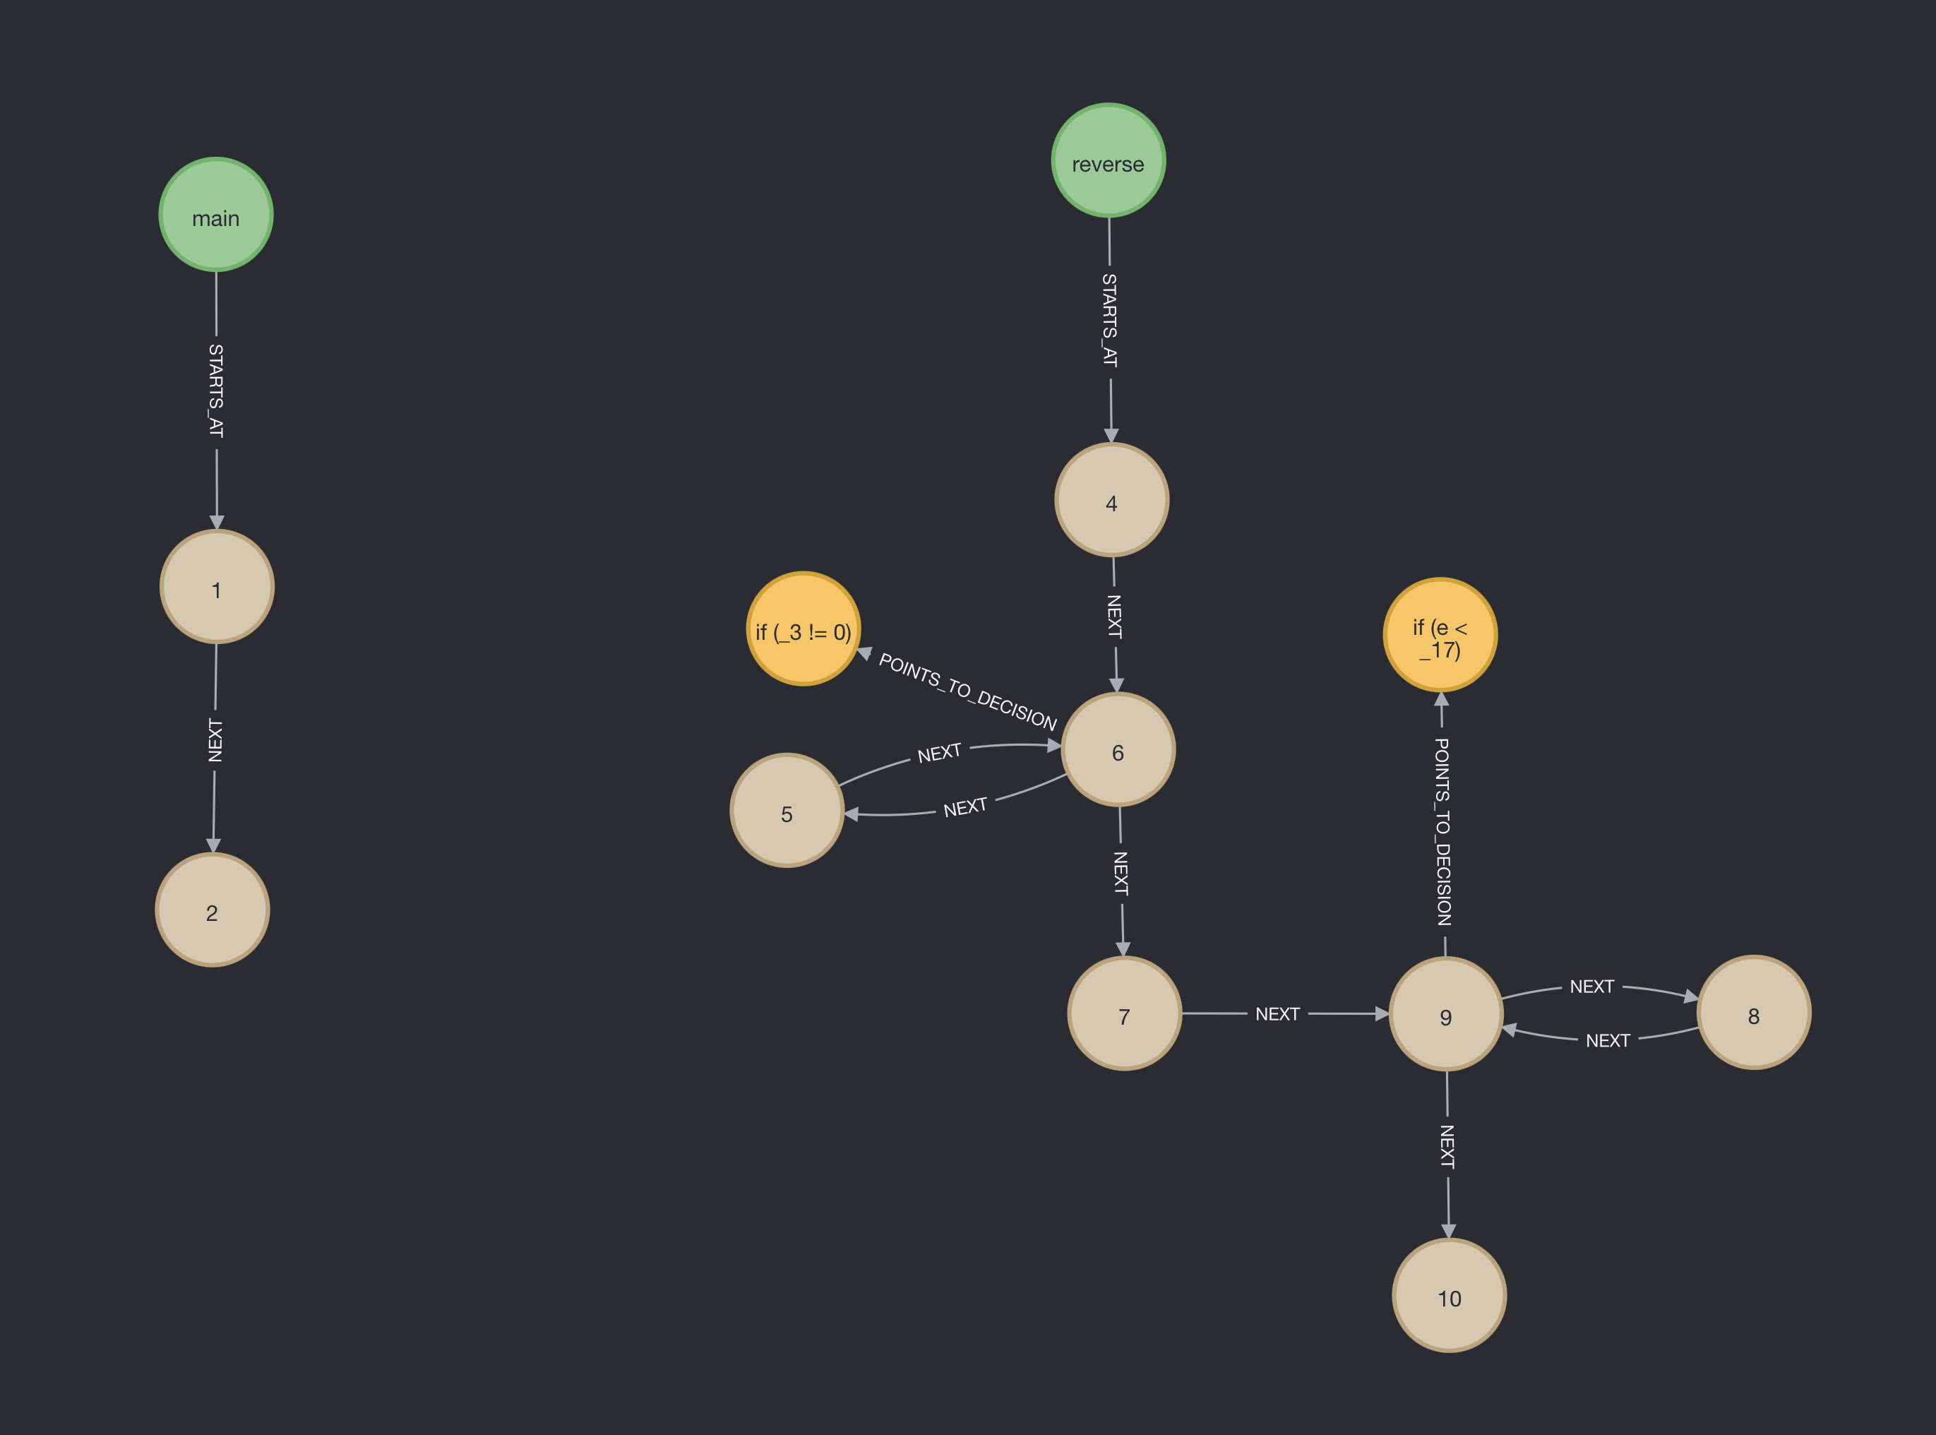
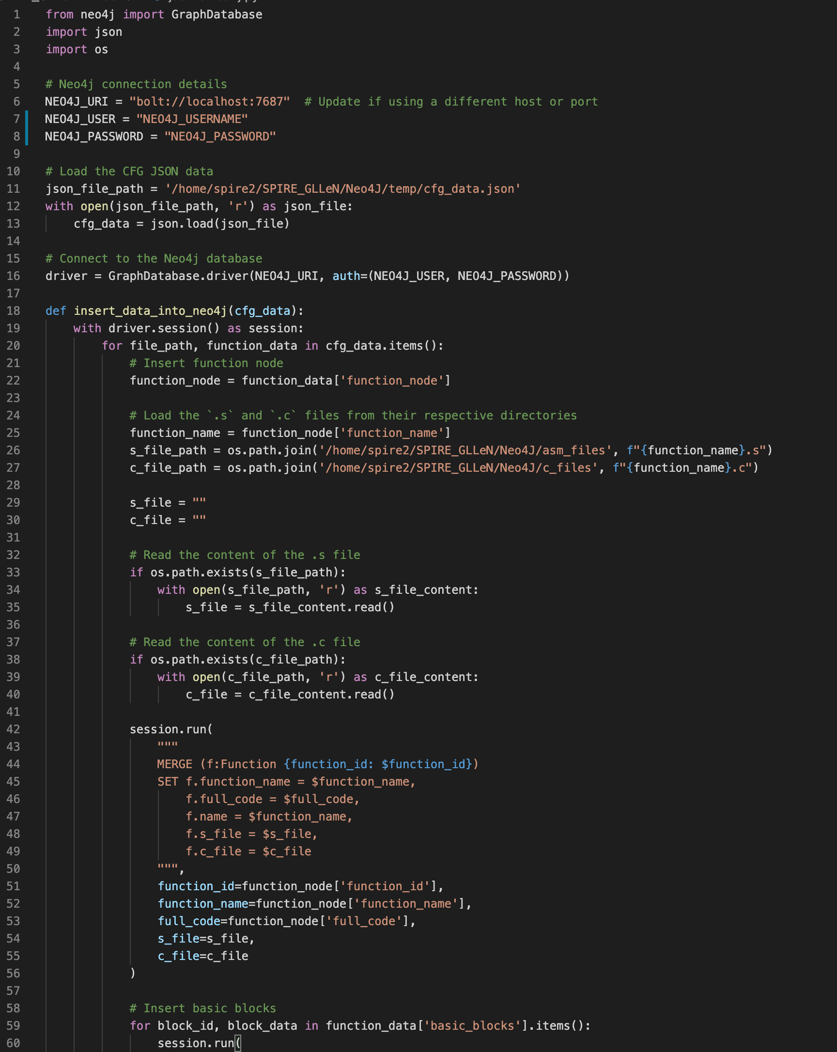
C files
Assembly files
CFG
JSON
Neo4j
Exebench
GCC
GCC
Python
Python
jsonToNeo4j.py

Slide 15
C files
Assembly files
CFG
JSON
Neo4j
Exebench
GCC
GCC
Python
Python

Slide 16
Building RAG Pipeline
DataBricks. (n.d.). RAG compared to LLM only. In A Compact Guide to Retrieval Augmented Generation (RAG) (p. 23). essay, Apache. Retrieved 2024,.

Slide 17
Was it valuable?
Yes?

Slide 18

Questions?

